Slide 1
Introduction to Predictive Modelling

Slide 2
What is Predictive modelling?
Statistical model created to best predict
the outcome
or
probability of an outcome
Models developed using
Historical data
or
Purposely collected data
Predictive analytics is used in financial services, insurance, telecommunications, retail, travel, healthcare, pharmaceuticals, sports and several other fields

Slide 3
Predictive modelling – General Approach
Step 1
Step 2
Setting
Business
Goal
Data
Understanding
and
Pre-Processing
Exploratory
Data
Analysis
Developing
Statistical
Model
Model
Evaluation
and
Validation
Model
Implementation
Step 3
Step 4

Slide 4
Multiple Linear Regression Introduction

Slide 5
Multiple Linear Regression
Multiple linear regression is used to explain the relationship between one continuous dependent variable and two or more independent variables.
The independent variables can be continuous or categorical.
The variable we want to model/predict is called the dependent variable
The variables used to predict the value of dependent variable are called independent variables (or explanatory variables/predictors).
Multiple linear regression requires the model to be linear in the parameters.
Example: The price house in USD can be dependent variable and area of house, location of house , air quality index in the area, distance from airport etc. can be independent variables.

Slide 6

Statistical Model
$$Y= b_{0}+b_{1}X_{1}+b_{2}X_{2}+ … +b_{p}X_{p}+e$$
where,
Y : Dependent Variable
X₁, X₂ ,…, X_{p} : Independent Variables
b₀, b₁ ,…, b_{p} : Parameters of Model
e : Random Error Component
Independent variables can either be continuous or categorical
Multiple linear regression requires the model to be linear in the parameters
Parameters of the model are estimated by the Least Squares Method.
The least squares (LS) criterion states that the sum of the squares of errors (or residuals) is minimum.
Mathematically, the following quantity is minimized to estimate parameters using the least squares method.
^
Error ss= Σ (Yi – Yi )2

Slide 7
Case Study – Modeling Job Performance Index
Background
Objective
Available Information
A company conducts different written tests before recruiting employees. The company wishes to see if the scores of these tests have any relation with post-recruitment performance of those employees.
To predict employees’ job performance index after probationary period, based on scores of tests conducted at the time of recruitment
Independent Variables: Scores of tests conducted before recruitment on the basis of four criteria – Aptitude, Test of Language, Technical Knowledge, General Information
Sample size is 33
Dependent Variable: Job Performance Index calculated after an employee finishes probationary period (6 months)

Slide 8
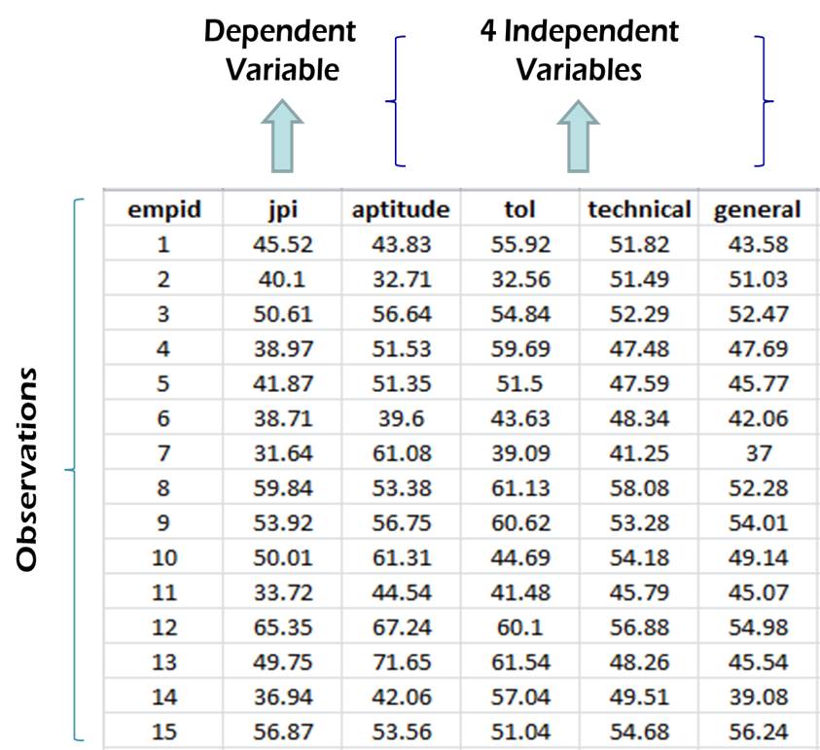
Data Snapshot
Performance Index
Columns | Description | Type | Measurement | Possible values
empid | Employee ID | integer | - | -
jpi | Job performance Index | numeric | - | positive values
aptitude | Aptitude score | numeric | - | positive values
tol | Test of Language | numeric | - | positive values
technical | Technical Knowledge | numeric | - | positive values
general | General Information | numeric | - | positive values

Slide 9
Model for the Case Study
Dependent Variable
Independent Variables
jpi = b₀ + b₁(aptitude) + b₂(tol) + b₃(technical) + b₄(general) + e
Parameter Estimates
Intercept / Constant
Error Term

Slide 10
Parameter Estimation using Least Square Method
Parameters | Coefficients
Intercept | -54.2822
aptitude | 0.3236
tol | 0.0334
technical | 1.0955
general | 0.5368
jpi= -54.2822 + 0.3236 (aptitude) + 0.0334 (tol) + 1.0955 (technical) + 0.5368 (general)

Slide 11

Parameter Estimation Using lm function in R
#Model Fit
jpimodel<-lm(jpi~aptitude+tol+technical+general, data=perindex) jpimodel
lm() fits a linear regression.
~ separates dependent and independent variables
Left hand side of tilde(~) represents the dependent variable and right-hand side shows independent variables
+ separates multiple independent variables.
#Output
Coefficients are the model parameters.
Signs of each parameter represent their relationship with the dependent variable.
*
~. in lm() function uses all variables except the dependent variable. This is helpful when the data has a large number of predictors.

Slide 12
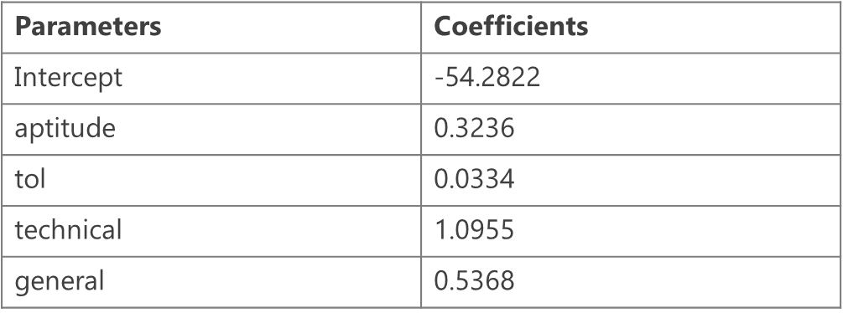
Interpretation of Partial Regression Coefficients
For every unit increase in the independent variable (X), expected value of the dependent variable (Y) will change by the corresponding parameter estimate (b), keeping all the other variables constant
From the parameter estimates table, we observe that the parameter estimate for the Aptitude Test is 0.3236
We can infer that for one unit increase in aptitude test score, the expected value of job performance index will increase by 0.3236 units

Slide 13

Individual Testing – Using t Test
Testing which variable is significant
Objective | To test the null hypothesis that parameters of individual variables are equal to zero
Null Hypothesis (H₀): b_{i} = 0
Alternate Hypothesis (H₁): b_{i} ≠ 0
where i = 1,2,…,p
Test Statistic
Decision Criteria | Reject the null hypothesis if p-value < 0.05
$$t = \frac{Estimatedb_{i}}{Standard Error of Estimated b_{i}}$$

Slide 14
Individual Testing – Using t Test
Parameters | Coefficients | Standard Error | t statistic | p-value
Intercept | -54.2822 | 7.3945 | -7.3409 | 0.0000
aptitude | 0.3236 | 0.0678 | 4.7737 | 0.0001
tol | 0.0334 | 0.0712 | 0.4684 | 0.6431
technical | 1.0955 | 0.1814 | 6.0395 | 0.0000
general | 0.5368 | 0.1584 | 3.3890 | 0.0021
p-values for aptitude, technical and general are < 0.05
p-value for test of language (tol) is > 0.05
Therefore, tol is the only insignificant variable

Slide 15

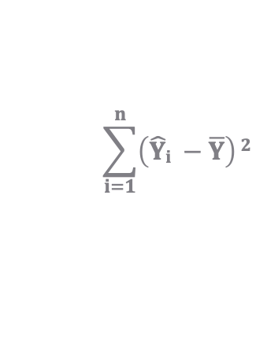

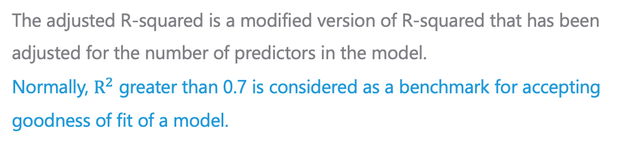
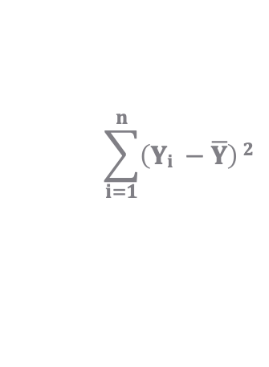
Measure of Goodness of Fit – R Squared
R² is the proportion of variation in the dependent variable which is explained by the independent variables. Note that R² always increases if variable is added in the model
$$\sum_{i=1}^{n}{\left(\hat{Y}i −\overline{Y}\right)}2$$
$$R^{2}=\frac{Explained Variation}{Total Variation}$$
$$=$$
$$\sum_{i=1}^{n}{\left(Yi −\overline{Y}\right)}2$$
The adjusted R-squared is a modified version of R-squared that has been adjusted for the number of predictors in the modelling.
The adjusted R-squared is a modified version of R-squared that has been adjusted for the number of predictors in the model. Normally, $R^{2}$ greater than 0.7 is considered as a benchmark for accepting goodness of fit of a model.

Slide 16
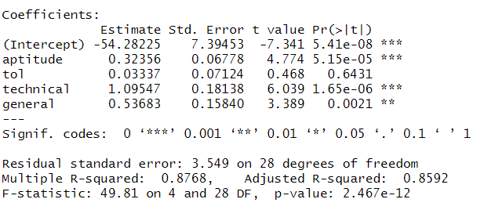
Understanding Summary Output
#Model Summary
summary(jpimodel)
summary() generates a detailed description of the model.
Interpretation :
Reject null hypothesis that no variables are significant as p-value is<0.05
aptitude, technical, general are significant variables (p-values<0.05)
tol is not significant (p-value>0.05)

Slide 17
Summary of Findings
Significant variables
Aptitude
Technical knowledge
General information
Out of four dependent variables, three affect job performance index positively
R²
0.88
88% of the variation in job performance index is explained by the model & 12% is unexplained variation

Slide 18
Fitted Values and Residuals
Fitted values (also called ‘Predicted Values’) are calculated using estimated model parameters and by substituting values of independent variables. The model now will include only the significant variables.
Estimated Model:
E(jpi)= -54.40644 + 0.33335*aptitude + 1.11663*technical + 0.54316*general
Values of Independent Variables for First Employee
aptitude | 43.83
tol | 55.92
technical | 51.82
general | 43.58

Slide 19
Fitted Values and Residuals
Values of Independent Variables for First Employee
aptitude | 43.83
technical | 51.82
general | 43.58
aptitude
technical
general
jpi= -54.40644 + 0.33335*43.83 + 1.11663*51.82 + 0.54316*43.58
Predicted jpi= 41.73850
Residual= Observed jpi – Predicted jpi = 45.52 - 41.73850 = 3.781497

Slide 20

Fitted Values and Residuals
#Model Fitting after eliminating the insignificant variable
jpimodel_new<-lm(jpi~aptitude+technical+general,data=perindex) jpimodel_new
The insignificant variable tol is not included in the new model
#Output
Estimated values of the model parameters using the new model
*
To get the fitted values and the residuals values, the model should include only the significant variables

Slide 21
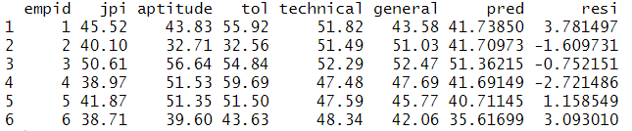
Fitted Values and Residuals
#Adding Fitted Values and Residuals to the Original Dataset
perindex$pred<-fitted(jpimodel_new) perindex$resi<-residuals(jpimodel_new)
fitted() and residuals() fetch fitted values and residuals respectively.
#Output
Interpretation :
pred values are calculated based on the values of the model parameters
resi is the difference between the actual jpi values and the pred values.
Lower the residuals, lesser is the difference between fitted and observed and better is the model.

Slide 22
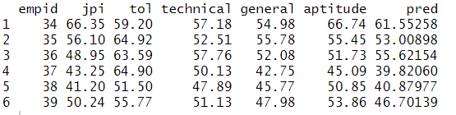
Predictions for New Dataset
New data set should have all the independent variables used in the model
Column names of all common variables in the new and old datasets should be identical
Note that missing values will be taken as 0 (which can be incorrect)
#Importing New Dataset
perindex_new<-read.csv("Performance Index new.csv", header=TRUE) perindex_new$pred<-predict(jpimodel_new,perindex_new) head(perindex_new)
predict() returns predicted values. Fitted model is the first argument and new dataset object is the second argument. This ensures R uses parameters from the fitted model for predictions on new data.

